Slide 1
1
CORE CONCEPTS
VUE
ADVANCED
5
CREATE WIDGETS
2
VUE CLI
4
ROUTING
3
VUE COMPONENTS

Slide 2


Slide 3
I have 2 data D1 and D2
I want to display the sum of D1 +D2
A
I create a new data
B
I create a method
C
I create a computed
D
I create a watch

Slide 4
I have 2 data D1 and D2
I want to display the sum of D1 +D2
A
I create a new data
B
I create a method
C
I create a computed
D
I create a watch

Slide 5
I have a data temperature that can be updated from different widgets,
If temperature = 0 , i need to send a request to the back
A
I create a new data
B
I create a method
C
I create a computed
D
I create a watch

Slide 6
I have a data temperature that can be updated from different widgets,
If temperature = 0 , i need to send a request to the back
A
I create a new data
B
I create a method
C
I create a computed
D
I create a watch

Slide 7
I have 2 data A and B
If i click on the button CLEAR, i want to set A and B to 0
A
I create a new data
B
I create a method
C
I create a computed
D
I create a watch

Slide 8
I have 2 data A and B
If i click on the button CLEAR, i want to set A and B to 0
A
I create a new data
B
I create a method
C
I create a computed
D
I create a watch

Slide 9
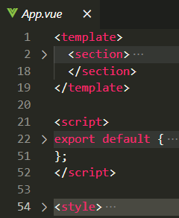
Does Chrome browser can understand this file ?
A
Yes, browsers can convert it to
HTML / JS /CSS
B
No, we need to build the HTML / JS /CSS
Before displaying the page on browsers
.vue file

Slide 10
Does Chrome browser can understand this file ?
A
Yes, browsers can convert it to
HTML / JS /CSS
B
No, we need to build the HTML / JS /CSS
Before displaying the page on browsers
NPM run serve
.vue file
NPM run build

Slide 11
What is the difference between
SOLUTION 1
SOLUTION 2
const app = {
data() {...}
}
export default {
data() {...}
}
A
Exactly the same
B
The solution 2 is wrong
C
With solution 2, the app can be used outside of the file

Slide 12
What is the difference between
SOLUTION 1
SOLUTION 2
const app = {
data() {...}
}
export default {
data() {...}
}
A
Exactly the same
B
The solution 2 is wrong
C
With solution 2, the app can be used outside of the file

Slide 13

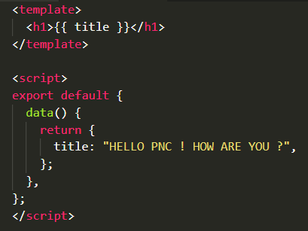
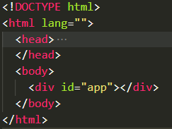
What will be the rendered HTML ?
main.js
App.vue
Index.html
A
{{ title }}
B
HELLO PNC ! HOW ARE YOU ?
C
Nothing displayed

Slide 14
What will be the rendered HTML ?
main.js
App.vue
Index.html
A
{{ title }}
B
HELLO PNC ! HOW ARE YOU ?
C
Nothing displayed

Slide 15
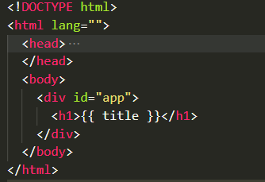
What will be the rendered HTML ?
main.js
App.vue
Index.html
A
{{ title }}
C
HELLO PNC ! HOW ARE YOU ?
HELLO PNC ! HOW ARE YOU ?
B
HELLO PNC ! HOW ARE YOU ?

Slide 16
What will be the rendered HTML ?
All content is replaced by the App content !
main.js
App.vue
Index.html
A
{{ title }}
C
HELLO PNC ! HOW ARE YOU ?
HELLO PNC ! HOW ARE YOU ?
B
HELLO PNC ! HOW ARE YOU ?

Slide 17
What are the 3 sections of the VUE file ?
A
Template + Code + Style
B
Template + Code + Css
C
Template + Script + Style
D
Template + Script + Css

Slide 18
What are the 3 sections of the VUE file ?
A
Template + Code + Style
B
Template + Code + Css
C
Template + Script + Style
D
Template + Script + Css

Slide 19
Which section is MADATORY on a Vue file ?
A
Template
B
Script
C
Style
D
All

Slide 20
Which section is MADATORY on a Vue file ?
A
Template
B
Script
C
Style
D
All

Slide 21
Which section is MADATORY on a Vue file ?
A
Template
B
Script
C
Style
D
All

Slide 22
VUE - CHAPTER 2
VUE
COMPONENTS

Slide 23
WHY
THIS
CLASS ?

Slide 24

Build a RICH web application

Slide 25
Re-use components in different views
VIEW 1
VIEW 2
NAV COMPONENT
NAV COMPONENT
CARD COMPONENT
CARD COMPONENT
CARD COMPONENT
CARD COMPONENT
CUSTOM BUTON
CUSTOM BUTON
CUSTOM BUTON
CUSTOM BUTON
CARD COMPONENT
CARD COMPONENT
CUSTOM BUTON
CUSTOM BUTON

Slide 26

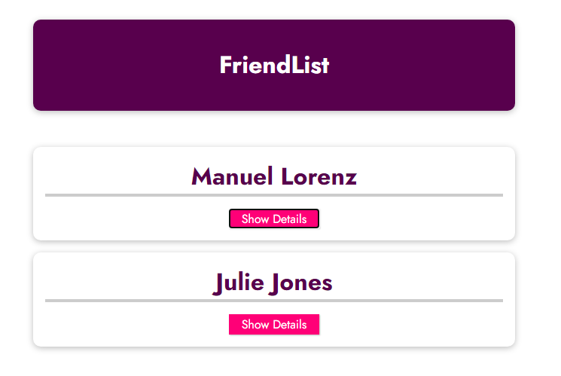
DEMO 1
The problem !
We want to show
Manuel Lorenz
details
But no
Julie Jones
Details !

Slide 27

ACTIVITY 1
10 MIN
Move this code into a VUE CLI project

Slide 28
DEMO 2
Let’s create a component !
STEP
APP
BY
STEP
< FRIEND-CARD>
< FRIEND-CARD>

Slide 29
To summarize :
A component is just like a “mini-app”
1 – Create a component in /src/components
<template></template>
<script></ script>
<style></ style>
FriendCard.vue
2 – Register the component in the app and give it a name
import FriendCard from "./components/FriendCard.vue";
const app = createApp(App);
app.component("friend-card", FriendCard);
Main.js
a component is a custom html element
Here it s : <friend-card>
3 – Use your component
<template>
<friend-card> </friend-card>
</template>
App.vue

Slide 30
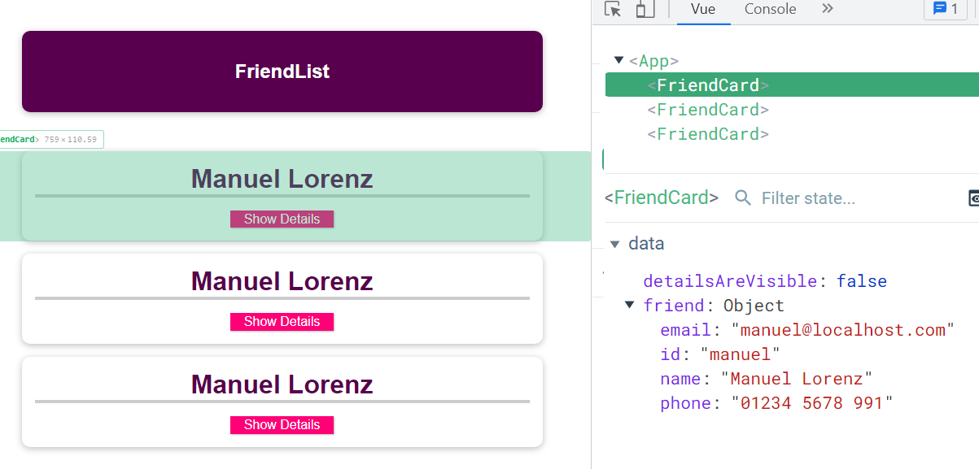
Now each card contains its OWN data

Slide 31
What about the style of components ?
A component can define its OWN style :
<template></template>
<script></ script>
<style></ style>
Style for this component
+ children components
A scoped attribute prevent the style from being forwarded to children components
<template></template>
<script></ script>
<style scoped ></ style>
Style for this component
+ children components

Slide 32
ACTIVITY 2
10 MIN
Create a component FriendCard.vue
Register the component on Main.js
Use the component on App.vue

Slide 33

TO READ DURING THIS CLASS
Maximilian Schwarzmüller. VueJS complete course - UDEMY
https://www.udemy.com/course/vuejs-2-the-complete-guide/learn/lecture/21463426#overview
Vue 3 official document
https://v3.vuejs.org/guide/single-file-component.html#introduction
Vue CLI official document
https://cli.vuejs.org/guide/
A full demo to build a poject (quiz app)
https://www.youtube.com/watch?v=4deVCNJq3qc&ab_channel=freeCodeCamp.org
Code style VueJS3.0
https://v3.vuejs.org/style-guide/

